Slide 1
Automated Phyto-Pathology Diagnostics using Deep Learning
Comparative Study of ViT, CRNN, and Graph-Based Architectures

Slide 2
Problem Statement & Objectives
The Problem: Plant diseases threaten global food security; manual identification is slow and error-prone.
Research Objective: To identify the most efficient DL architecture for 38 disease classes.
The Approach: Evaluate four distinct paradigms:
Vision Transformers (Global Attention)
CRNN (Spatial-Sequential Hybrid)
GCNN/GRCNN (Non-Euclidean Graph modeling)

Slide 3
Dataset Overview
Volume: 54,305 total images across 38 classes.
Complexity: Includes healthy leaves and diverse diseases (Bacterial, Fungal, Viral).
Data Splits:
Train: ~48k images.
Validation: ~1.2k images.
Independent Test: 8,147 hold-out images.
Preprocessing: 256x256 resolution, Label Smoothing (0.1) to prevent overfitting.

Slide 4
Architecture 1 – Optimized CRNN (The Winner)
Backbone: Convolutional layers for high-fidelity spatial feature extraction.
Innovation: * Spatial Attention: Focuses on the "lesion" areas of the leaf.
Bi-LSTM: Treats spatial features as a sequence to capture structural dependencies.
Why it worked: It combines the local precision of CNNs with the global structural awareness of RNNs.

Slide 5
Architecture 2 – Graph-Based Models (GCNN/GRCNN)
GCNN: Models leaves as non-Euclidean graphs. Great for geometry but lacked depth for complex 38-class patterns.
GRCNN: An evolution using memory-gated units (Recurrent) to manage dependencies between spatial points.
Performance: Achieved ~79% validation accuracy, proving the "Graph" approach is promising but requires more computational refinement for this specific dataset.

Slide 6
Architecture 3 – Vision Transformer (ViT)
Mechanism: Multi-head Self-Attention.
Results: 69% Accuracy (Lowest in the study).
Analysis: * Time: Highest training time per epoch (554s).
Constraint: Requires significantly larger datasets or massive pre-training to outperform hybrid models on leaf-specific textures.

Slide 7
Comparative Performance Analysis

Slide 8
Final Evaluation Results
Independent Test Set (8,147 Images)
Test Accuracy: 98.59%
Macro F1-Score: 0.9813 (Consistent across all 38 classes)
Weighted F1-Score: 0.9900
Inference Speed: Optimized for real-time diagnostic applications.

Slide 9
Discussion & Conclusion
CRNN Dominance: Treating the leaf surface as a sequence allowed the model to "read" disease patterns more effectively than looking at them as a whole (ViT) or as a static graph (GCNN).
Computational Efficiency: CRNN was nearly 3x faster than ViT per epoch while delivering much higher accuracy.
Future Work: Deploying the model onto edge devices (Mobile/IoT) for field-based diagnosis.

Slide 10
Live Demo & Repository
Deployment: Hosted on Hugging Face Spaces.
https://huggingface.co/spaces/hamzabinabdulmajeed/Plant-Disease-Diagnostic
Reproducibility: All notebooks are open-access on Kaggle.
https://www.kaggle.com/code/hamzabinbutt/plantvillage-eda
https://www.kaggle.com/code/hamzabinbutt/plantvillage-baseline-crnn
https://www.kaggle.com/code/hamzabinbutt/plantvillage-gcnn
https://www.kaggle.com/code/hamzabinbutt/plantvillage-grcnn
https://www.kaggle.com/code/hamzabinbutt/plantvillage-baseline-vit

Slide 11
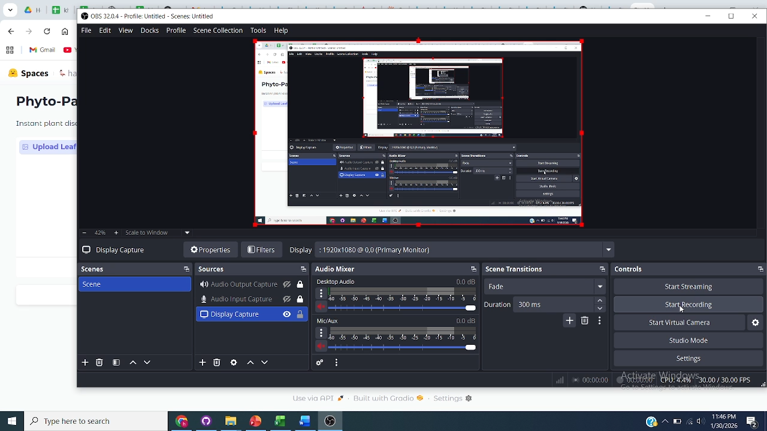
Working Demo

